Slide 1
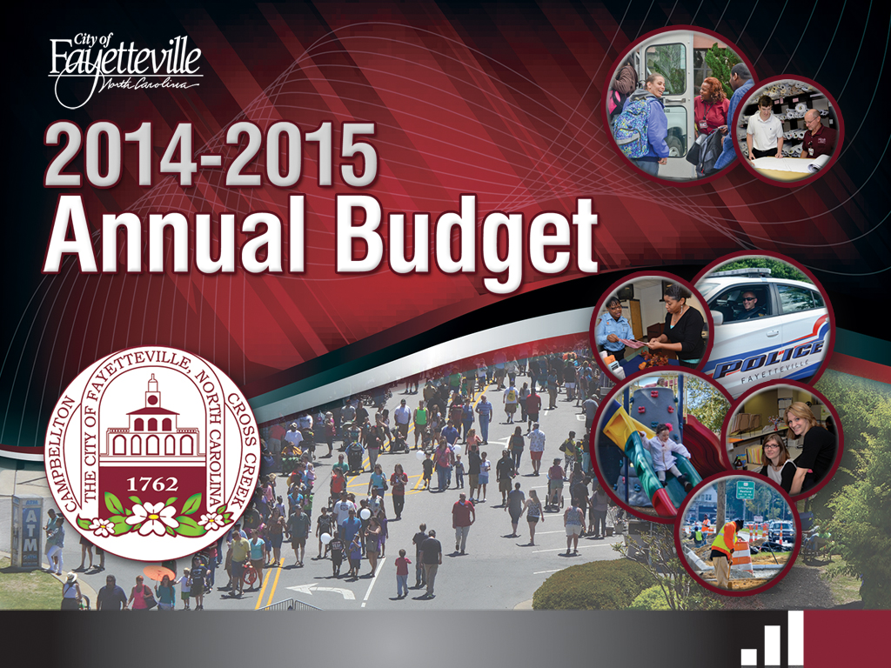
Recommended
May 12, 2014

Slide 2


Budget
Presentation
Peer comparisons
Decision filters
  Strategic Plan
  Budget Development Guidelines
General Fund Revenues/Expenditures
New Initiative Tax Package
Other Highlights
Upcoming Calendar
Notes:
Brief outline of what I intend to cover this evening

Slide 3

Peer Comparisons
Notes:
Before we get into the budget itself which is essential a description of REVENUES and EXPENDITURES, I’d like to take a moment and provide a bit of context

Slide 4
Property Tax
Peer Comparisons
Property Taxes
  Low tax base
  Low tax rate
  Unusually low property tax revenue per capita
  Minimal impact on economy
?
Notes:
Before recommending a tax increase, it is prudent to take a look at the history of Fayetteville’s tax rates, the tax rates of our Cumberland County municipal governments, and the tax rates of our peer cities state-wide. As discussed at the Strategic Planning Retreat and Council Orientation, Fayetteville has a relatively low tax base when compared to the ten largest cities in North Carolina, and does not have the industrial property that these cities have. Average home values in Fayetteville are lower than our peer cities, though our commercial tax base makes up a similar proportion of total assessable property. Nevertheless, this commercial property is not necessarily of high value. The net result is a low tax base overall, which when multiplied by a relatively low tax rate, results in an unusually low property tax revenue stream per capita. This is illustrated in the chart below.

Slide 5
Fayetteville generates $288.24 per capita from property taxes, the lowest of peer cities. The comparative data for the peer cities ranges from $434.96 to $578.25. If the estimated population on Fort Bragg (24,909) is excluded from the total Fayetteville population (207,996), Fayetteville’s per capita property tax revenue calculates at $327.46.
Notes:
So we are lower. Just HOW MUCH lower are we?

Slide 6
The chart represents a standard deviation of the mean property tax revenue per capita. The data demonstrates that Fayetteville’s property tax revenue per capita is $288.24, which falls two deviations below the mean $488.21.
Notes:
More than 2 standard deviations from the mean.

Slide 7
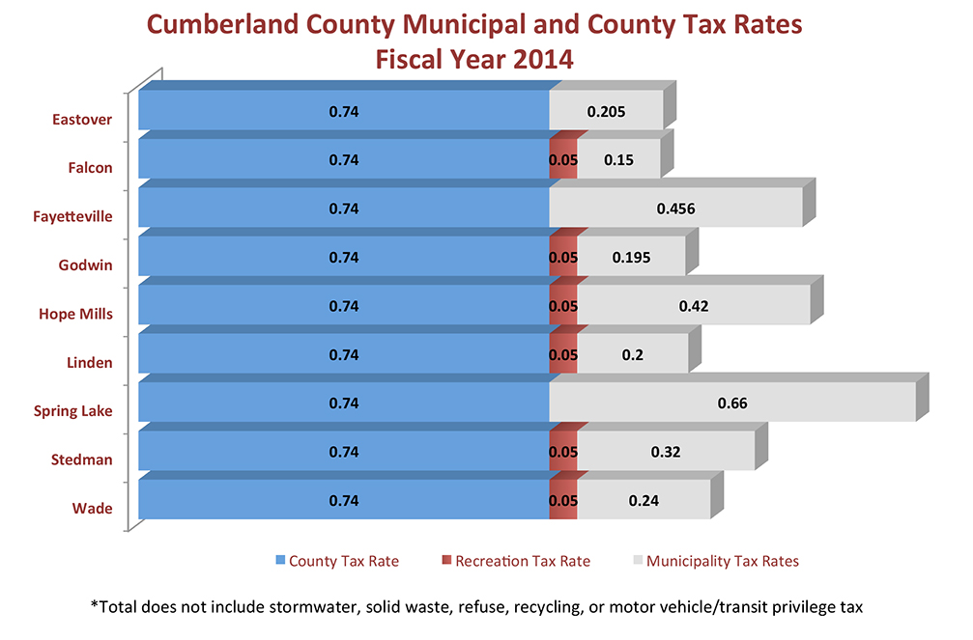
Cumberland County Comparisons
Notes:
Now that we have compared our property tax burden

Slide 8
Public Safety Spending
Notes:
Now that we know we have a low tax burden, what do we do with the money we get?

Slide 9
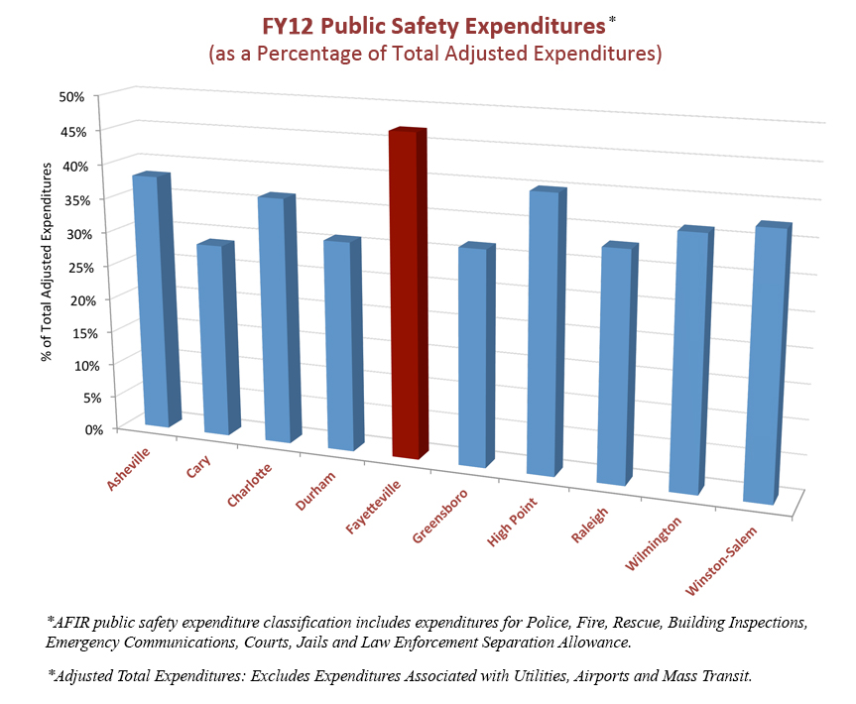
Notes:
Fayetteville spends a greater percentage of its budget on Public Safety. Since Public Safety is our top priority, so that’s a good thing, right?

Slide 10
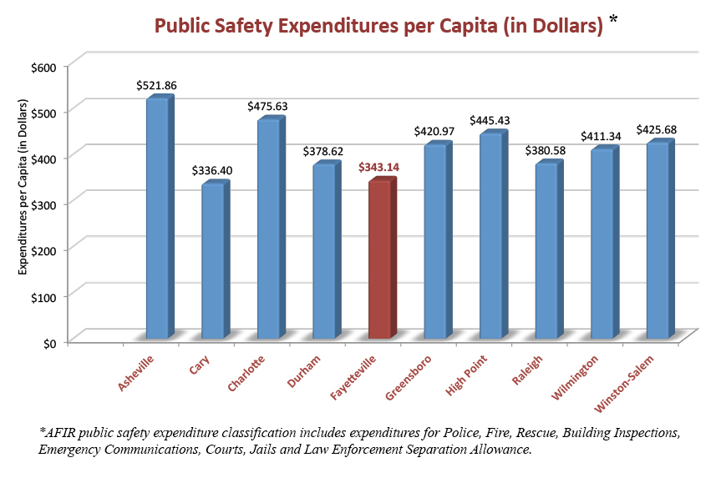
Notes:
Unfortunately not. As you can see here, when we convert the data from percentage of budget to dollars per citizen, we see that we are almost the lowest of the group. What this means is, that we simply aren’t collecting the revenue we need so we end up spending a disproportionate amount on public safety, which doesn’t match our peer cities, and then we neglect everything else.
Now that we have some context, let’s talk about our priorities – the decision filters used to start this year’s budget process.
So this is good news, right? Fayetteville’s leaders understand that the community wants to focus on public safety, and this is happening. While the City of Fayetteville does spend a greater proportion of municipal resources on public safety, the following chart illustrates how this may not be such a good thing after all. It turns out, that when this information is converted to actual dollars, on a per capita basis, Fayetteville expended $343.14, which was the second lowest of the peer cities.

Slide 11
Decision Filters

Slide 12

Decision Filters
Strategic Plan
City Council Budgetary Guidelines

Slide 13
Strategic Plan

Slide 14
Strategic Plan
Council’s Top Five Priorities Include:
Police staffing
Establish broader citywide economic development program
Parks & Recreation capital project funding
Customer service initiative throughout the organization
Development of a Comprehensive Land Use Plan

Slide 15
Budget Guidelines
Highlights

Slide 16
Budget Guidelines
Highlights
Accommodate City Council strategic priorities
Evaluate tax rate and services consistent with Council priorities
Evaluate MSD tax rates
  Fund all public safety, police and fire positions no longer supported by grants
  Dedicate no less than 5.25 cents of tax rate for capital funding plan
Notes:
This is abbreviated

Slide 17
Budget Guidelines
Highlights
  Add current year service enhancements to the base budget
  Take action consistent with Resolution 2013-052
  Make acceleration of water and sewer service to City residents a priority
  CIPs for City operations, including utility operations, shall be presented to Council in advance of general budget consideration

Slide 18
General Fund
Revenues/Expenditures

Slide 19
Major Highlights
Recommends general tax rate of 49.8 cents per $100 value, an increase of 4.2 cents
Projects unassigned fund balance at 11.0%
Advances Council’s five strategic priorities
Funds the CIP/ITP
Transitions to program budget with performance measures
Continues to support best practice reviews of City support services

Slide 20

General Fund
Revenue Highlights
Permits and Fees
  Proposed fee adjustments for:
    Development Services permits, fees and planning services ($167K)
    Parks and Recreation after-school program and summer camp/playground ($35K)

Slide 21
General Fund
Revenue Highlights
Interfund Transfers
  Interfund transfer from the Electric Fund is projected to increase by 1.8% over FY2014
    $12.5 million in FY2015 compared to $12.3 million in FY2014
Capital Lease Proceeds
  FY2015 proposed budget includes $2.11 million in loan proceeds to purchase vehicles

Slide 22

General Fund
Expenditure Highlights
$1.6M* for 2% performance increases for general employees and police upper ranks
  police step plan remains unchanged
4.7% vacancy rate savings for all GF departments except Fire/Mayor/Council, plus Environmental Services ($2.7M)
$225K for parks bond referendum and education campaign
Fleet replacements and refurbishment ($2.3M)
Additional vehicles associated with new initiatives ($2.2M)
Notes:
* Adjustment to be made to leave step plan unchanged

Slide 23
General Fund
Expenditure Highlights
FY2015 transfer of $3.5M to the utility system is for water and sewer projects and debt service in annexed areas
FY2015 transfers to other funds include:
  $6.1M to Environmental Services Fund
  $3.7M for street resurfacing
  $3.5M to Transit Fund
  $1.4M for information technology projects
  $2.2M for other transportation projects
  $1.5M for facility renovations and improvements
  $0.9M for loan repayment to Risk Management Fund
  $0.5M for facility repairs

Slide 24
General Fund
Expenditure Highlights
Fund Balance Appropriation
  Fund balance appropriation for FY2015 of $1.9 million is 44.4 % less than FY2014 appropriation of $3.5 million
  FY2015 appropriation of $1.9 million for one-time uses including $1.6 million for various capital improvement and information technology projects

Slide 25
New Initiative
Tax Package

Slide 26
Tax Package
4.2 cent tax increase for:
  Police staffing phased in over two fiscal years
    57 sworn officers
    4 civilian crash investigators
    7 police support positions
    1 assistant city attorney
    3 information technology positions
    Assumes $388K grant to fund 4 of the officer positions
  Police facilities
    Cross Creek District Office
    Planning for crime lab

Slide 27
Tax Package
4.2 cent tax increase for:
  Broader economic development program
    1 community redevelopment manager
    1 marketing and business development manager
    1 administrative assistant
  Customer service initiative
    1 customer advocate and 2 building inspectors
  Comprehensive land use plan
    1 planner

Slide 28

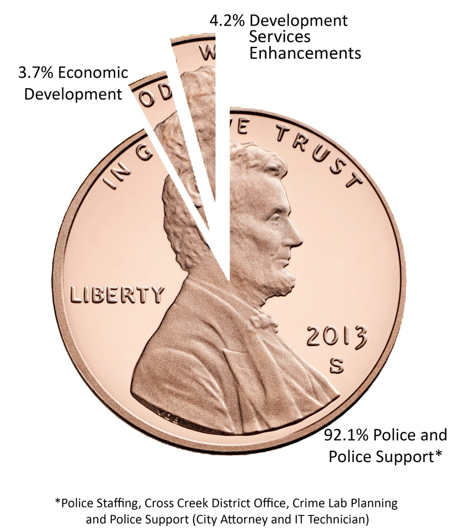
Total Proposed Tax
Increase by Expenditure

Slide 29
Other Highlights

Slide 30
Other Highlights
Stormwater utility fee
  Currently $3.00 per month (ERU)
  Proposed at $3.50 per month
    Annual increase of $6 to produce an additional $879K per year
    Primary purpose of increase is to fund storm drainage system improvements

Slide 31
Other Highlights
Environmental Services Fund
  Annual increase of $2 to produce an additional $121K
    $38 annual solid waste fee increases to $40
    Equates to $3.33 fee per month
    Purpose of increase is to reduce subsidy from General Fund
    Provides contribution toward curbside household and yard waste, recycling, bulky item service
  $1.09 million in capital lease proceeds to finance vehicles

Slide 32
Other Highlights
Environmental Services Fund
  Customer service initiative
    Transition to automated collection trucks continues to improve service
    Without increasing costs
      Created an excess debris crew
      Added a route administrator
Notes:
We are doing some things without new revenues – always trying to find ways to be more effecient

Slide 33
Other Highlights
Transit Fund
  Customer service initiative
    Added 2 full-time customer service representatives in place of temporary agency services
  Added 4 full-time bus operators in place of overtime and temporary employees
  Added a civil rights analyst in place of an office assistant (grant funded)

Slide 34
Other Highlights
Municipal Service Districts – Property Tax Rates
    Propose Central Business District remain unchanged at 10.0 cents per $100 value
    Lake Valley Drive Municipal Service District
      Current rate is 34.5 cents per $100 value
      Propose 24.5 cents for FY2015

Slide 35
Budget Process and Document
Budget Process
  December
    Conduct annual budget kick-off session with staff
    Review CIP/ITP project requests
  January
    Departments prepare
      Current year estimates and new year base operating and capital requests
      New initiatives and program priorities
    CIP/ITP requests prioritized and recommended 5-year plan developed
Notes:
How did we get here?

Slide 36
Budget Process and Document
Budget Process
  February
    Conduct City Council strategic planning retreat
    Present Recommended 5-year CIP/ITP to Council
  March/April
    Present departmental budget submissions to Council
    City Manager
      reviews budget submissions, including electric, water, waste water and fleet maintenance service funds
      develops recommended program priorities and budget based on feedback from the strategic planning retreat

Slide 37
Budget Process and Document
Budget Process
  May/June
    Conduct budget work sessions
      May 14 and 21
      May 28 and June 2, if needed
      One budget session devoted to PWC budget
    Conduct public hearing on May 27
    Adopt the budget and related documents on June 9

Slide 38
Upcoming
Calendar
May 14: Budget Work Session
May 21: Agenda Briefing &
Budget Work Session
May 27: Regular Council Meeting
Tentative Budget Public Hearing
May 28: Budget Work Session (if needed)
June 9: Budget Ordinance Adoption
Notes:
Fayetteville Outfront
www.fayettevilleoutfront.com
FAYTV7
www.faytv7.com

Slide 39


