Slide 1

Permits When they are required
29 February 2024

Slide 2

General Statutes
There are two statute sections that outline when permits are required or not.
NCGS §143-138
NCGS §160D-1110
This presentation is only going to show 160D-1110 as both statutory references mimic each other.

Slide 3
160D-1110 a –a1(BUILDING)
§ 160D-1110. Building permits.
(a)Except as provided in subsection (c) of this section, no person shall commence or proceed with any of the following without first securing all permits required by the State Building Code and any other State or local laws applicable to any of the following activities:
  (1)The construction, reconstruction, alteration, repair, movement to another site, removal, or demolition of any building or structure
The language in here requires a permit for any new, renovation, repair, or demolition (BUILDING) of a building or structure; however in 160D-1110 (c) modifies this.

Slide 4
160D-1110 (c)
(c)No permit issued under Article 9 or 9C of Chapter 143 of the General Statutes is required for any construction, installation, repair, replacement, or alteration performed in accordance with the current edition of the North Carolina State Building Code costing fourty thousand dollars ($40,000) or less in any single-family residence, farm building, or commercial building unless the work involves any of the following:
(1)The addition, repair, or replacement of load-bearing structures. However, no permit is required for replacement of windows, doors, exterior siding, or the pickets, railings, stair treads, and decking of porches and exterior decks that otherwise meet the requirements of this subsection

Slide 5
160D-1110(c)
The language here exempts work for non-load bearing structures (walls). Load –bearing is defined as
“A wall that supports both its weight and the vertical load produced by slabs, beams, other walls, etc. is referred to as a load-bearing wall.”
A non-load bearing wall only supports it’s own weight (dead load)
Note that insulation is not in the statutory language and requires a permit. See also NCGS §143-139.2 Enforcement of Insulation requirements; certificate for occupancy; no electric service without compliance

Slide 6
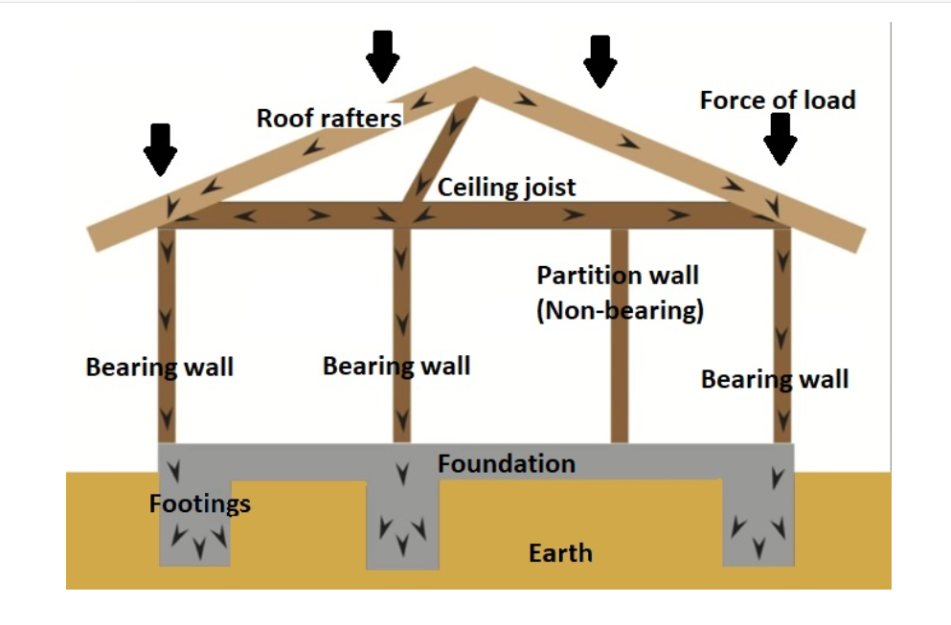
Examples

Slide 7
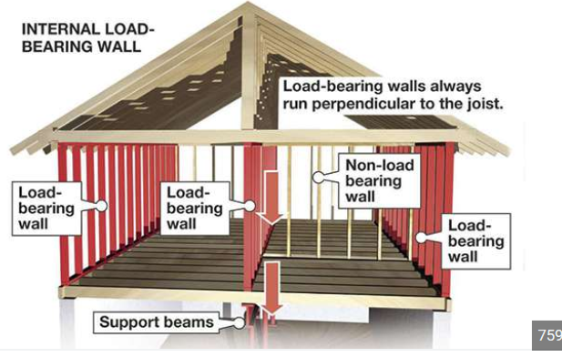
Examples

Slide 8
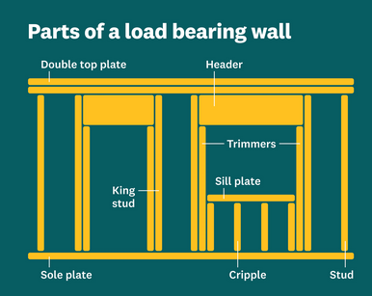
Examples

Slide 9
160D-1110 (a)(2) (Plumbing)
(2)The installation, extension, or general repair of any plumbing system except that in any one-or two-family dwelling unit a permit is not required for the connection of a water heater that is being replaced if :
the work is performed by a person licensed under G.S.87-21 who personally examines the work at completion and ensures that a leak test has been performed on the gas piping, and
(ii) the energy use rate or thermal input is not greater than that of the water heater that is being replaced, there is no change in fuel, energy source, location, capacity, or routing or sizing of venting and piping, and the replacement is installed in accordance with the current edition of the State Building Code

Slide 10
160D-1110 (a)(2)
160d-1110 (a)(2) is the like for like on water heaters if installed by a North Carolina Licensed Plumbing Contractor, then a permit is NOT required.
160D-1110 (c)(2) also modifies this section:
(2)The addition or change in the design of plumbing. However, no permit is required for replacements otherwise meeting the requirements of this subsection that do not change size or capacity.

Slide 11
160D-1110 (c)(2)
As 160D-1110 (c)(2) outlines that a permit is NOT required if the plumbing piping is being replaced. This can constitute changing from cast-iron or copper to plastic piping (PVC or PEX).
This exemption does not include adding plumbing piping (water supply or DWV {drain, waste, and venting}) or redesigning the water supply or DWV piping.

Slide 12
160D-1110 (a)(3)(Mechanical)
(3)The installation, extension, alteration, or general repair of any heating or cooling equipment system
All work (mechanical) requires a permit !! This is even doubled down in 160D-1110 (c)(3)
(3)The addition, replacement, or change in the design of heating, air-conditioning, or electrical wiring, devices, appliances, or equipment, other than like-kind replacement of electrical devices and lighting fixtures.

Slide 13
160D-1110 (a)(4)(Electrical)
(4)The installation, extension, alteration, or general repair of any electrical wiring, devices, appliances, or equipment, except that in any one-or two-family dwelling unit a permit is not required for repair or replacement of electrical lighting fixtures or devices, such as receptacles and lighting switches, or for the connection of an existing branch circuit to an electric water heater that is being replaced if all of the following requirements are met:
a. With respect to electric water heaters, the replacement water heater is placed in the same location and is of the same or less capacity and electrical rating as the original.
b. With respect to electrical lighting fixtures and devices, the replacement is with a fixture or device having the same voltage and the same or less amperage.
c. The work is performed by a person licensed under G.S.87-43.
d. The repair or replacement installation meets the current edition of the State Building Code, including the State Electrical Code.

Slide 14
160D-1110 (a)(4)
However, a building permit is not required for the installation, maintenance, or replacement of any load control device or equipment by an electric power supplier, as defined in G.S.62-133.8, or an electrical contractor contracted by the electric power supplier, so long as the work is subject to supervision by an electrical contractor licensed under Article 4 of Chapter 87 of the General Statutes. The electric power supplier shall provide such installation, maintenance, or replacement in accordance with (i) an activity or program ordered, authorized, or approved by the North Carolina Utilities Commission pursuant to G.S.62-133.8 or G.S.62-133.9 or (ii) a similar program undertaken by a municipal electric service provider, whether the installation, modification, or replacement is made before or after the point of delivery of electric service to the customer. The exemption under this subsection applies to all existing installations. UTILITIES !!!!

Slide 15

160D-1110 (C)
(c)No permit issued under Article 9 or 9C of Chapter 143 of the General Statutes is required for any construction, installation, repair, replacement, or alteration performed in accordance with the current edition of the North Carolina State Building Code costing forty thousand dollars ($40,000) or less in any single-family residence, farm building, or commercial building unless the work involves any of the following:
(1)The addition, repair, or replacement of load-bearing structures. However, no permit is required for replacement of windows, doors, exterior siding, or the pickets, railings, stair treads, and decking of porches and exterior decks that otherwise meet the requirements of this subsection.
(2)The addition or change in the design of plumbing. However, no permit is required for replacements otherwise meeting the requirements of this subsection that do not change size or capacity.
(3)The addition, replacement, or change in the design of heating, air-conditioning, or electrical wiring, devices, appliances, or equipment, other than like-kind replacement of electrical devices and lighting fixtures.
(4)The use of materials not permitted by the North Carolina State Building Code.
(5)The addition (excluding replacement) of roofing.
(6)Any changes to which the North Carolina Fire Prevention Code applies.

Slide 16
160D-1110 (d) (Multi-Trade)
(d)A local government shall not require more than one building permit for the complete installation or replacement of any natural gas, propane gas, or electrical appliance on an existing structure when the installation or replacement is performed by a person licensed under G.S.87-21 or G.S.87-43. The cost of the building permit for such work shall not exceed the cost of any one individual trade permit issued by that local government, nor shall the local government increase the costs of any fees to offset the loss of revenue caused by this provision.

Slide 17
160D-1110 (d)
Note the requirements for this permit:
Must be an existing structure (residential or commercial). Does not apply for new construction or additions,
Must be North Carolina licensed contractors,
Does NOT have to be a like for like replacement,
Can be new install on existing structure.

Slide 18
160D-1110 (d)
This statute applies to heating & air conditioning appliances, water heaters (if not a like for like replacement), and replacing generators (if not replacing the transfer switch)
On HVAC/R appliances; ductwork, electrical wiring, and gas piping is part of the multi trade permit as long as it is part of the appliance being installed and does NOT include other parts of the building. The same applies to water heaters.
The North Carolina Office of the State Fire Marshal (engineering division) has issued a formal (binding) interpretation on this statute.
https://www.ncosfm.gov/formal-interpretations/221128-fayetteville-nc-development-services-2018-ncacp-1061-permit-required

Slide 19
160D-1110 (e-h)
160D-1110 (e & f) talks about not issuing any building permits unless land disturbing activity permits have been obtained (Engineering)
(g) refers to the owner affidavit exemption
(h) says we cannot withhold a permit if legally entitled to one if another property or parcel has issues.

Slide 20
Additional Statutory References
Unmanned utility buildings, including telecommunication structures do NOT require a building permit. North Carolina Building Code section 101.2 **
Parking lot light poles and solar panel installations are electrical permits*** unless roof has construction to support weight. NCOSFM interpretation,
Farm buildings. (interpretation changes to much to clariff when a building permit is required or not)
Green houses for farming use only does not require a building permit. NCGS 143-138 (b4)(2)

Slide 21
Therapeutic Equine Facility does not require a building permit.** Does not require a building permit with proof that they are a 501(c)(3) tax exempt with the Internal Revenue Code.
Roadside Farm Market does not require a building permit if less than 1000 square feet and not open more than 180 days per year. NCGS 143-138 (b4)(1)(b)
Primitive Camp Structure 143-138 (b4)(4)

Slide 22


